Slide 1

STUDENT NUMBER: 222146410
SURNAME, INITIALS: OBENEMBOT MA
CSC3A MINIPROJECT
TOPIC: BLOCKCHAIN HEALTH CARE

Slide 2




PROBLEM STATEMENT

Slide 3
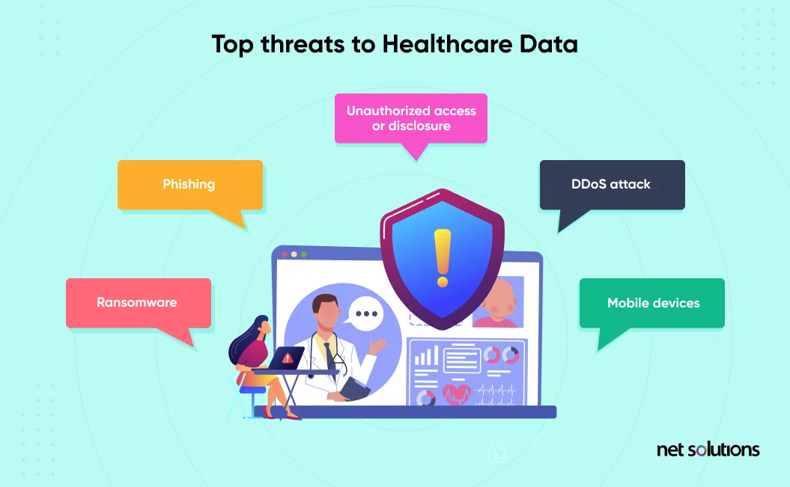
PATIENT DATA
One concern is the possibility that someone could find out something about a person’s medical history, and use it against them. Some people are worried about the loss of privacy, damage to their reputation, or discrimination if someone finds out about their condition. This may be especially true for anyone with a condition they feel sensitive about.

Slide 4
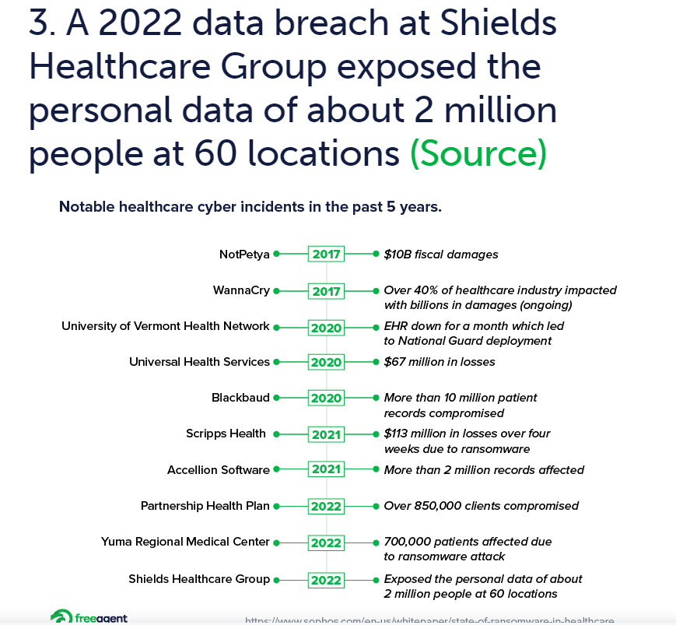
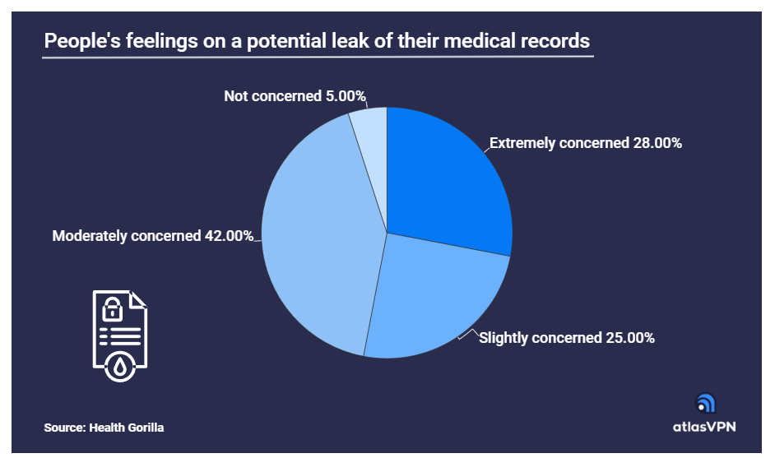
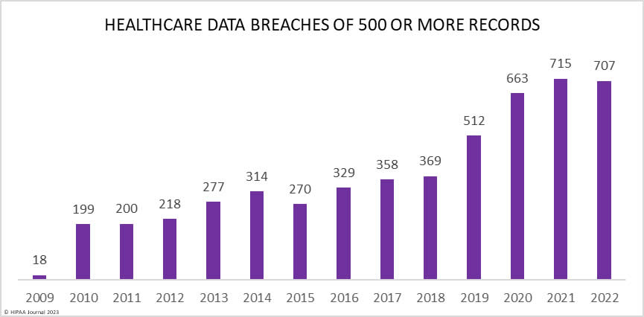
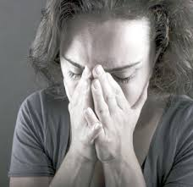
STATISTICS ON POOR DATA MANAGEMENT

Slide 5

Solution
BLOCKCHAIN
Decentralization
Immutability
Transparency
Security
Nonrepudiation
PATIENT
Record Data
Capture DateTime
DOCTOR
Query Data
View Stats
Display Record

Slide 6
DEMO
YOUTUBE UNLISTED VIDEO LINK: https://youtu.be/MwlEG61znBw?feature=shared

Slide 7
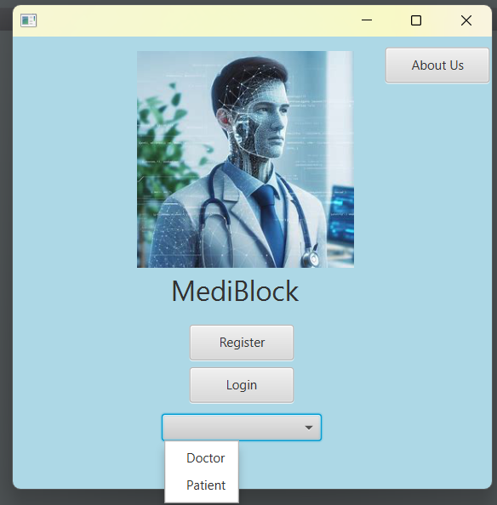
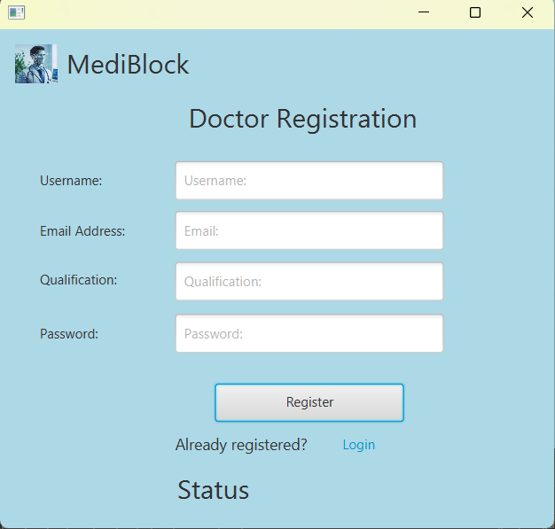
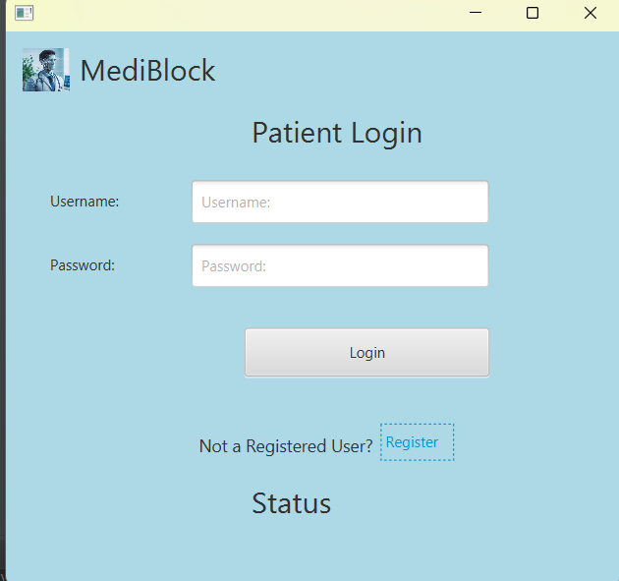
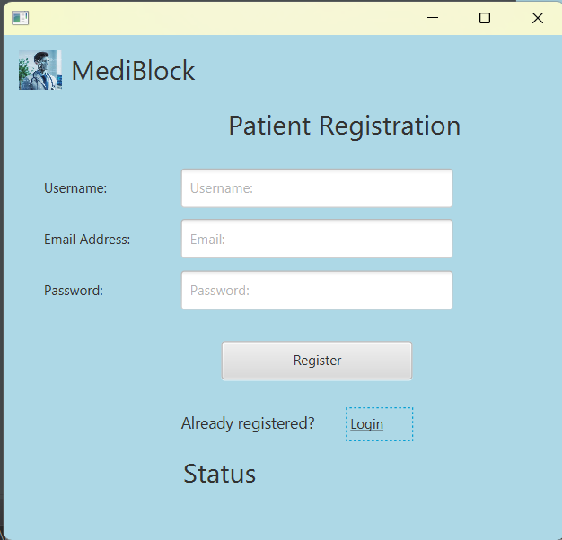
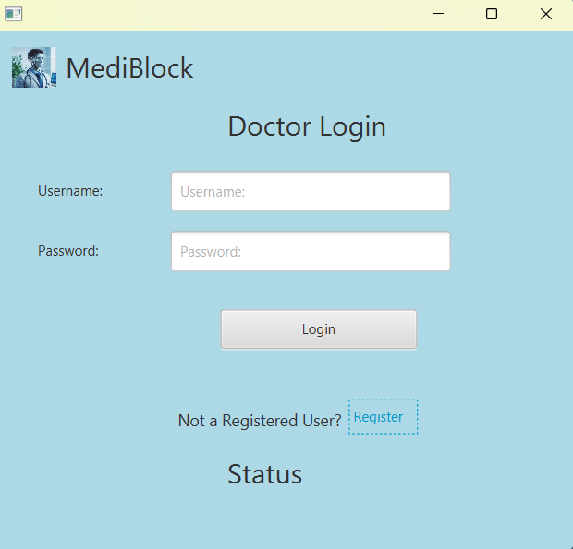
SCREENSHOTS: HOME PAGE

Slide 8
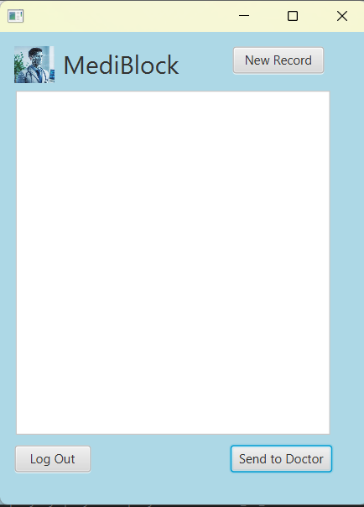
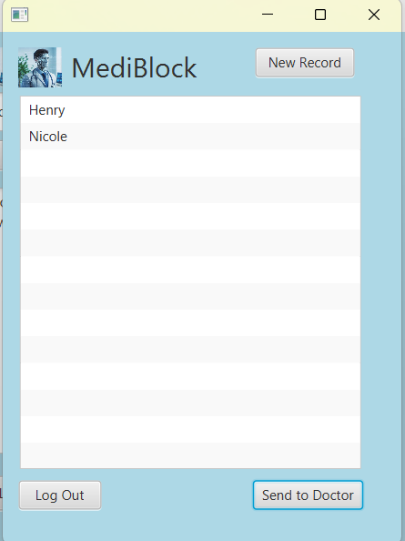
SCREENSHOTS: PATIENT PAGE

Slide 9
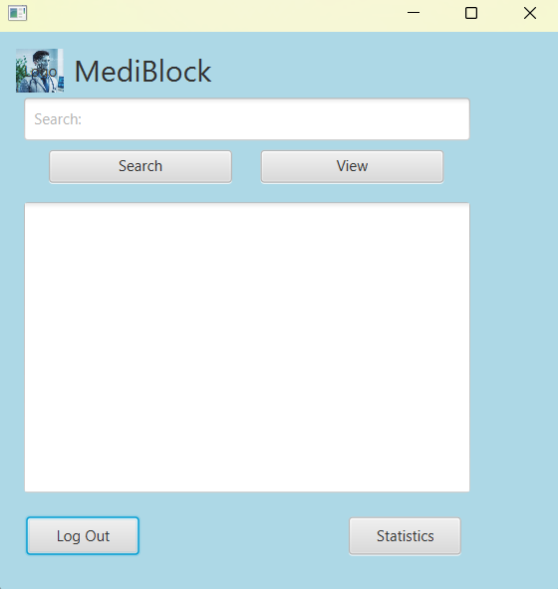
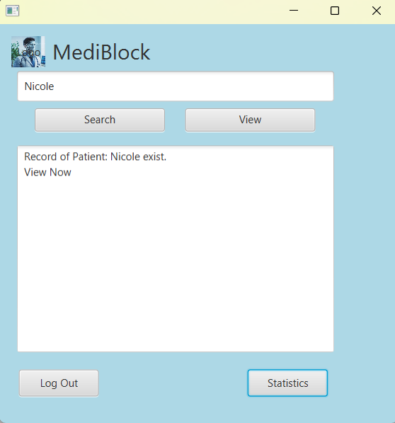
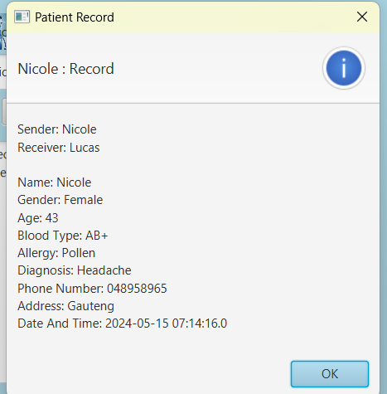
SCREENSHOTS: DOCTOR PAGE

Slide 10
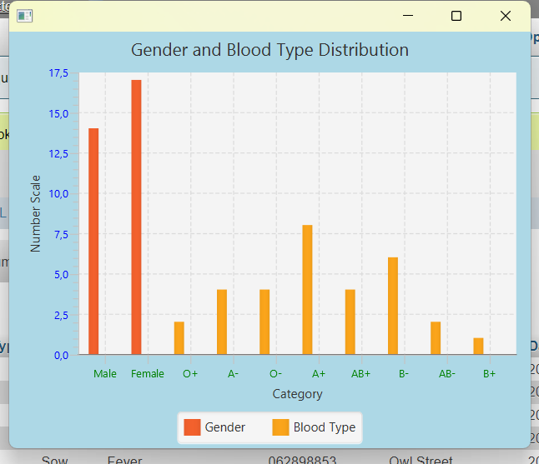

Slide 11
